Slide 1
Introduction to Machine Learning Part I
Mehran Behjati
Notes:
<number>

Slide 2
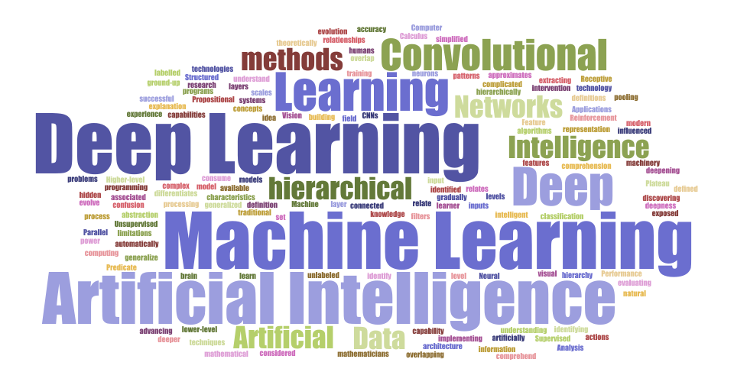

Slide 3
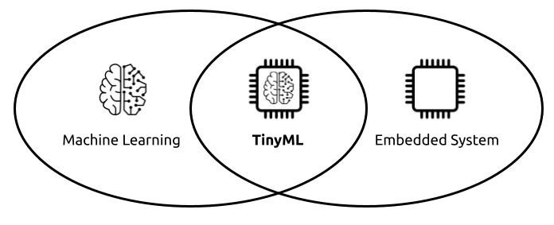
Layout
i
ii
iii
What is AI, ML, & DL
ML vs TinyML
ML enablers
iv
v
ML Limitations
ML Process

Slide 4
AI ML DL
AI
DL
ML
AI
AI
ML
DL
ML
DL

Slide 5
What is AI, ML & DL?
Notes:
<number>

Slide 6
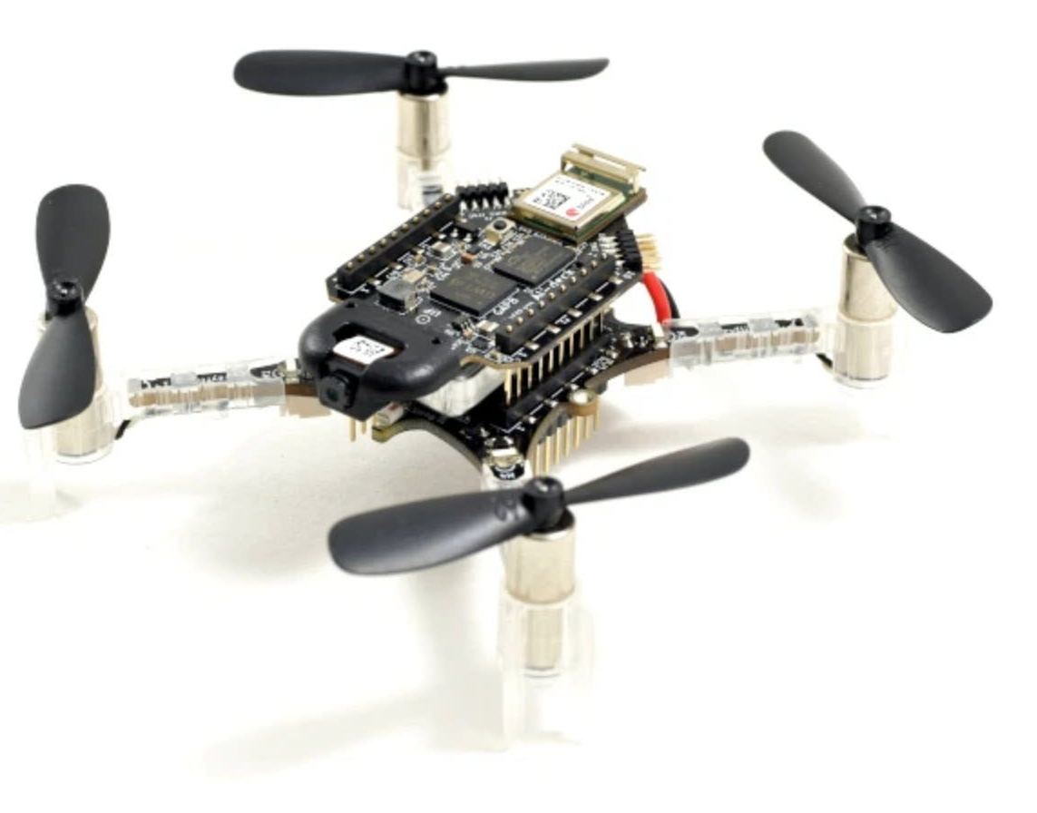
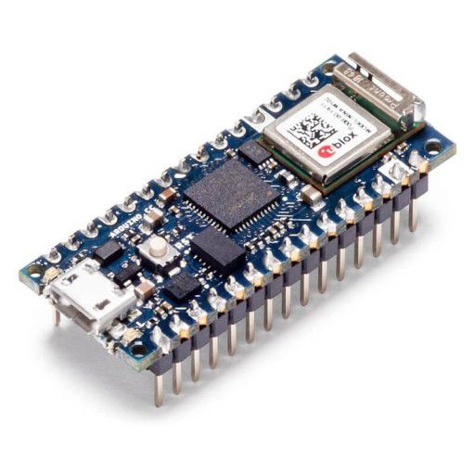
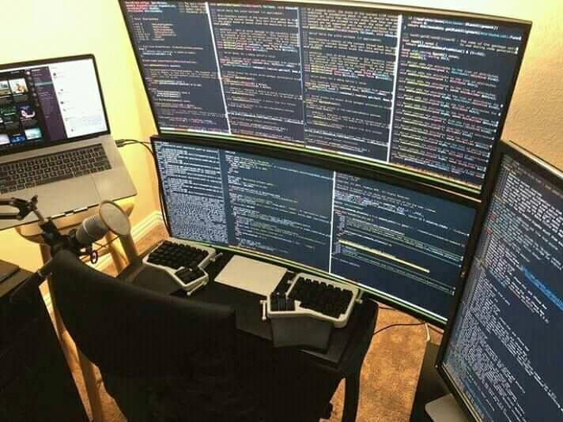
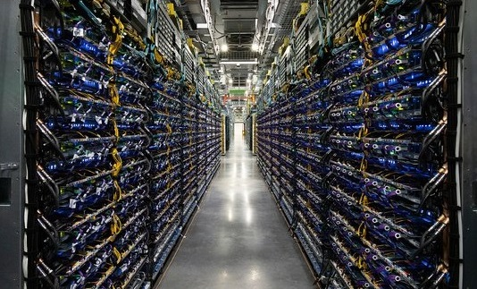
ML vs TinyML
ML
More powerful
Longer processing
More power consumption
TinyML
Less powerful
Light processing
Power efficient

Slide 7
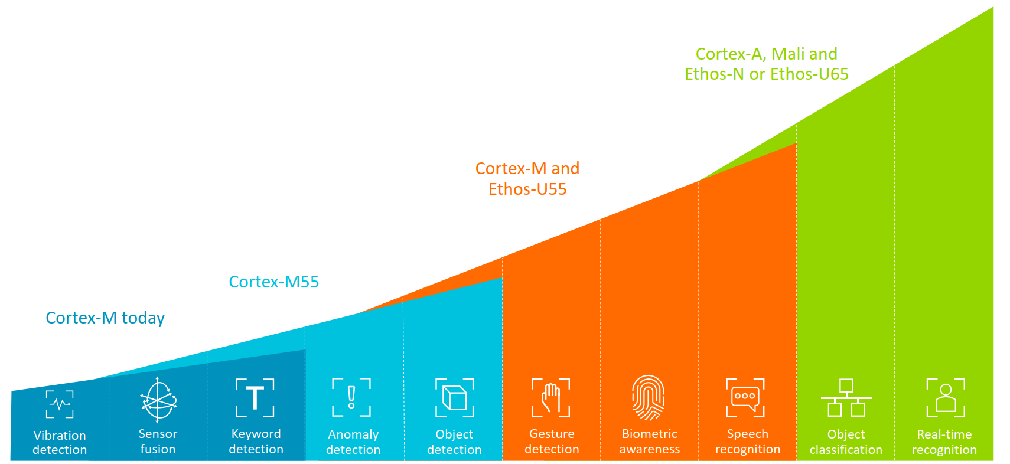
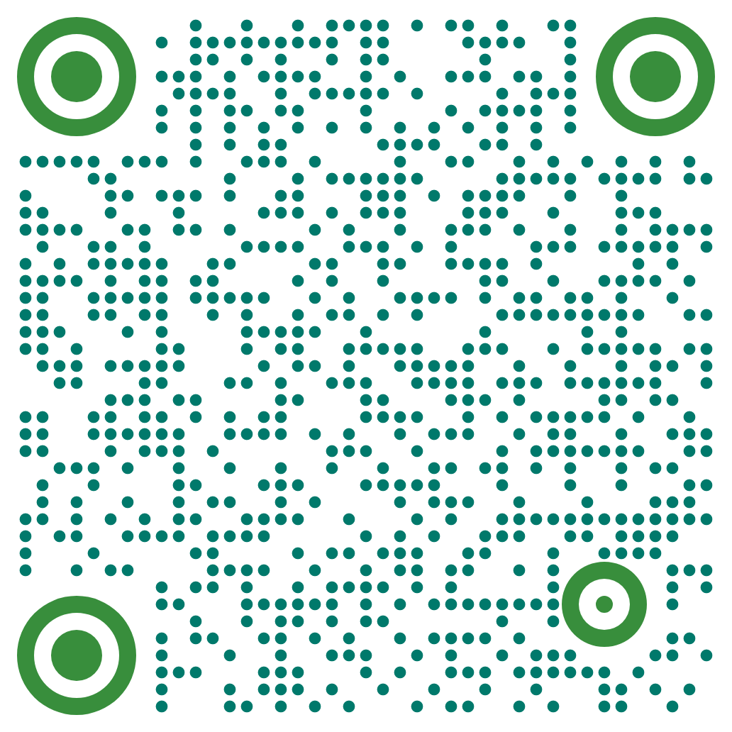
Some TinyML Applications

Slide 8
Traditional algorithms vs ML algorithms
Traditional
ML
Data
Rules
Inference phase
Training phase
algorithm
Data
Answer
Data
ML
ML
Answers
Rules
Predictions

Slide 9
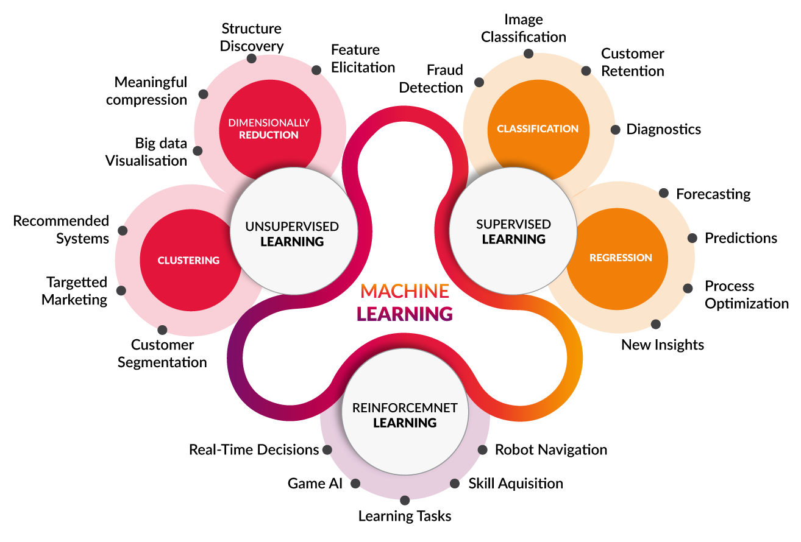
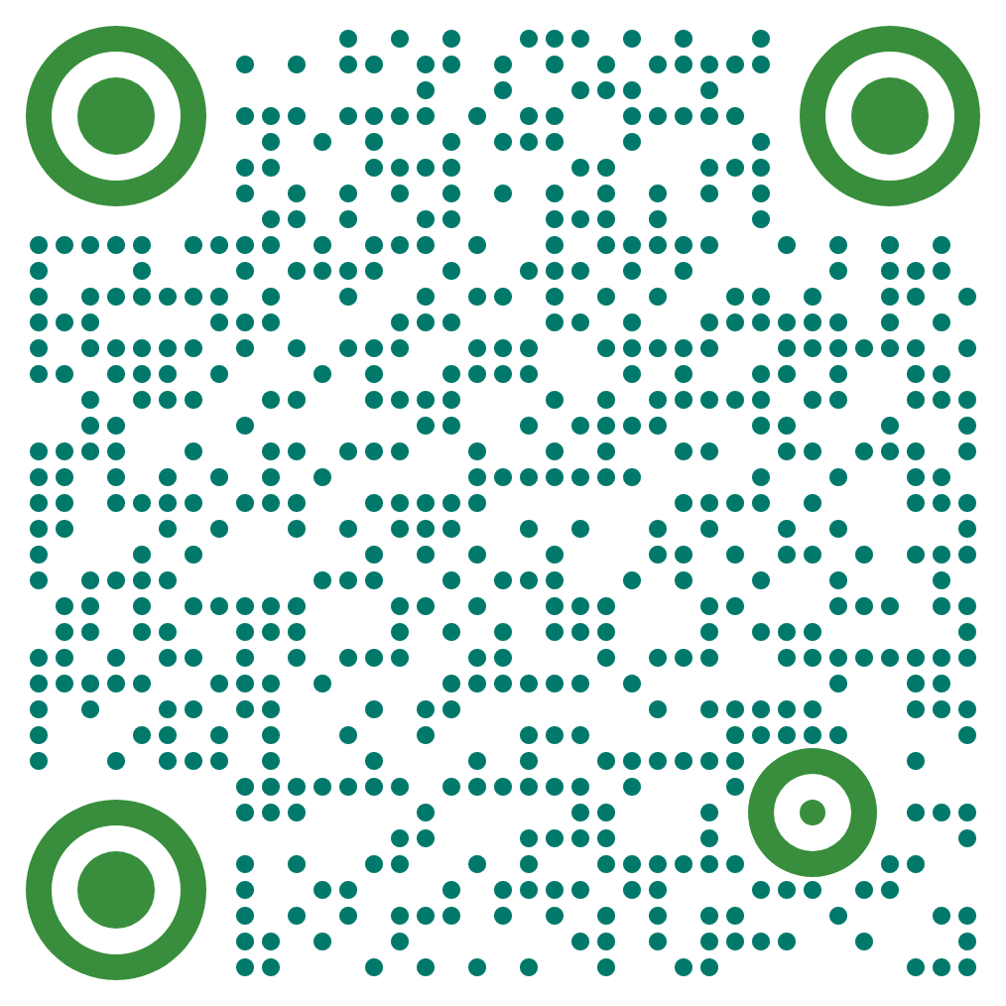
ML Categories

Slide 10
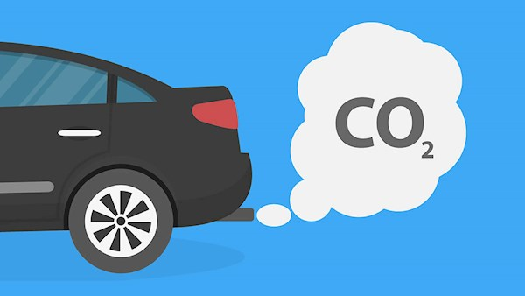
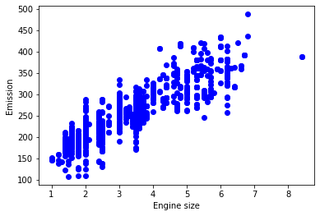
Regression

Slide 11
Classification

Slide 12
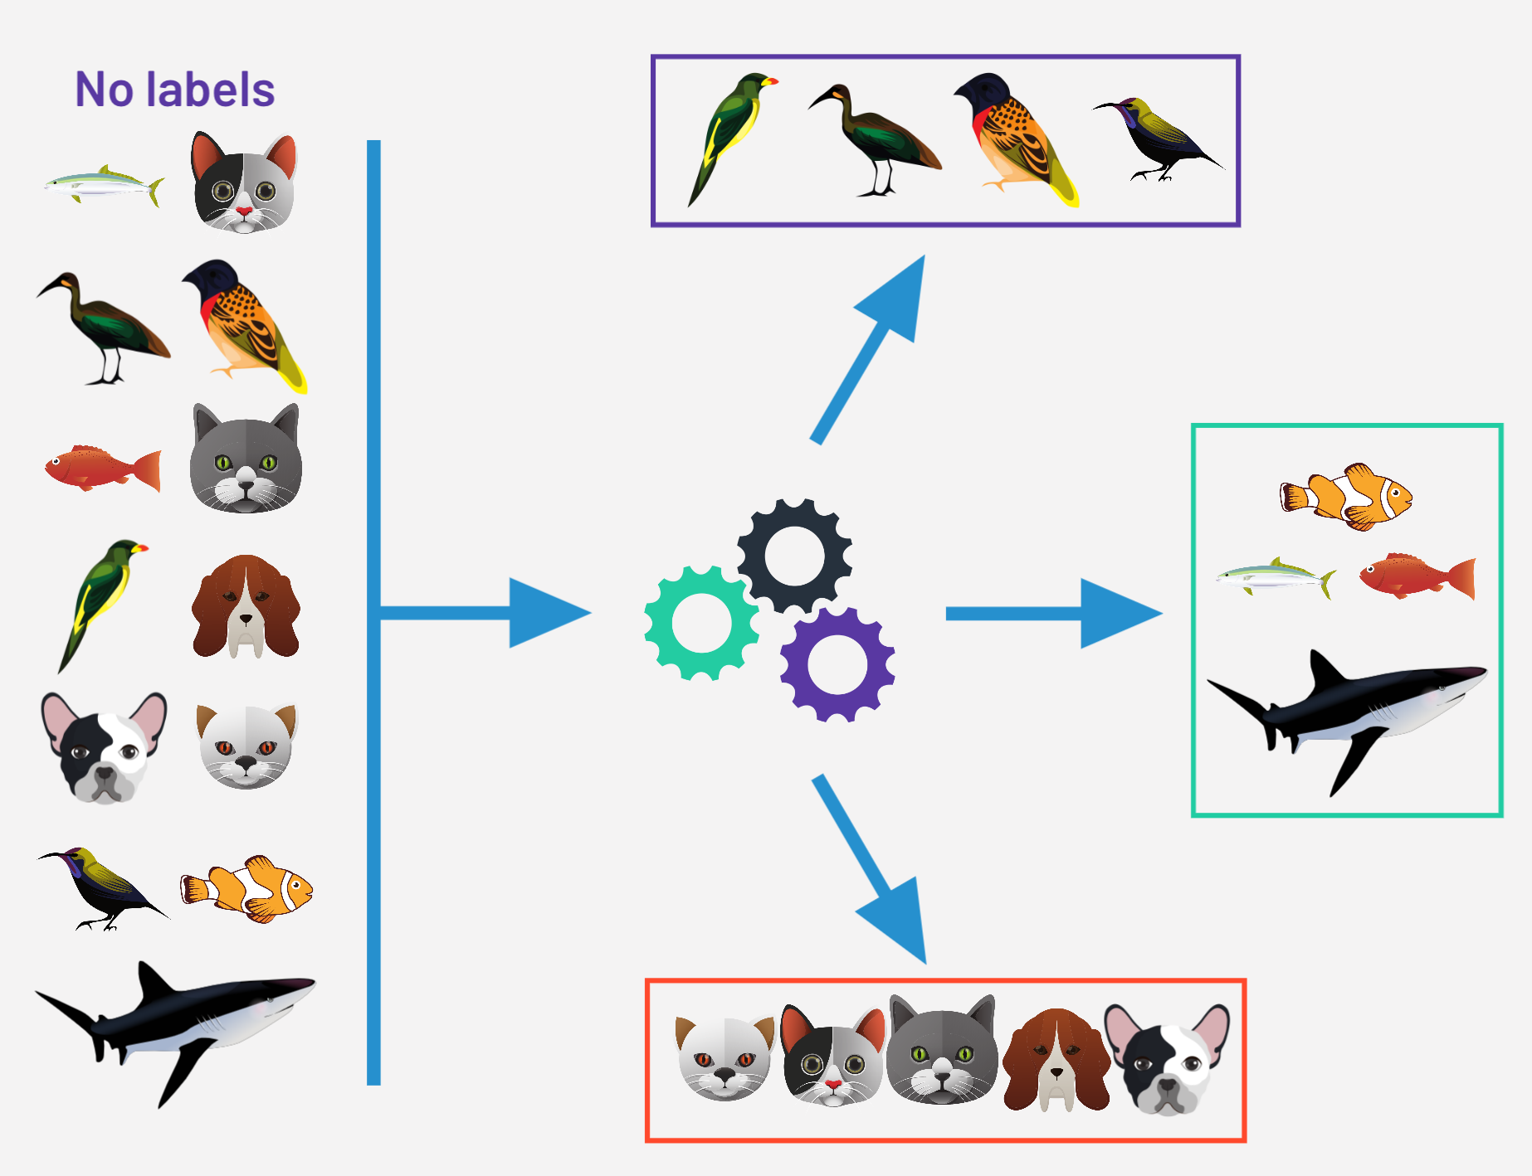
Clustering
It is unsupervised, so there is no label

Slide 13
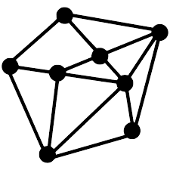
ML Enablers
Data availability
Algorithm advancement,
Optimized software library & CMSIS-NN optimization algorithms
Open source framework, TensorFlow Lite (TinyML)
Computational power
TPU, GPU
Cortex-M, microNPUs (TinyML)
Public/industry interest/demand

Slide 14
ML Limitations
Probabilistic vs Deterministic
ML by its nature is probabilistic
Data
Lack of data in some cases / lack of good data
Interpretability
Misapplications
Power and Cycle constraints (TinyML)
need for HW & SW optimization
Notes:
<number>

Slide 15
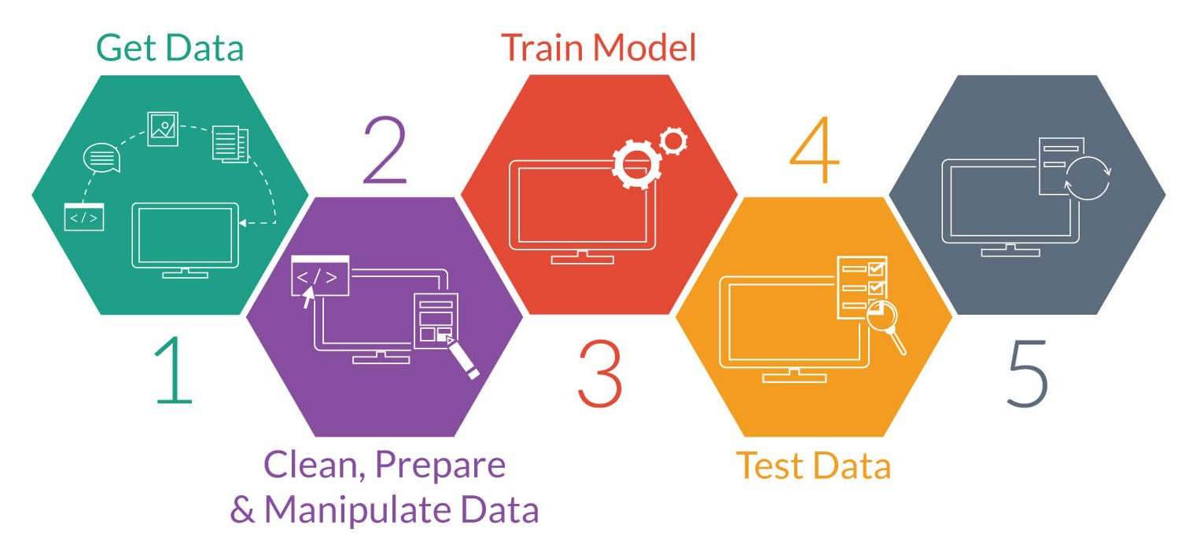
ML Process
Model Deployment

Slide 16
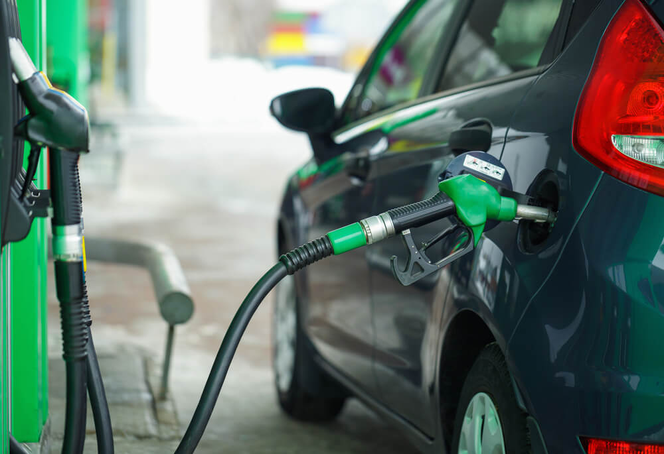
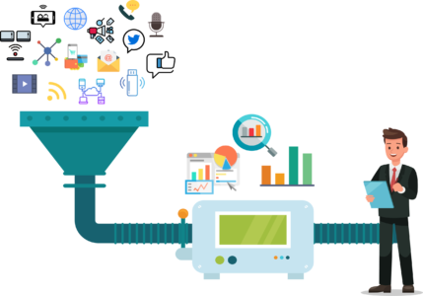
Data & ML

Slide 17
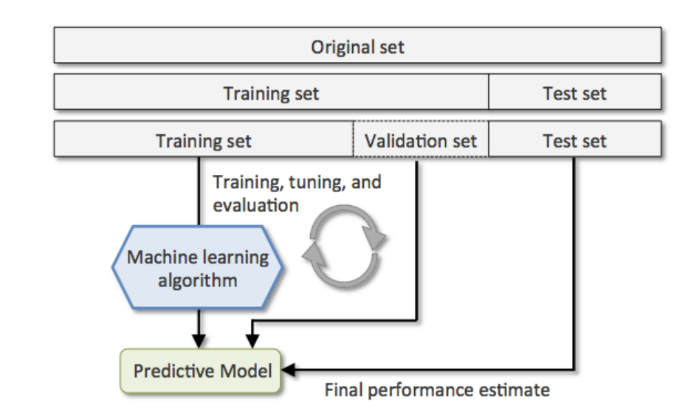
How to build a dataset for ML
Why do we need data?
Training dataset: The sample of data used to fit the model.
Validation Dataset: The sample of data used to provide an unbiased evaluation of a model fit on the training dataset while tuning model hyperparameters.
Test Dataset: The sample of data used to provide an unbiased evaluation of a final model fit on the training dataset.

Slide 18
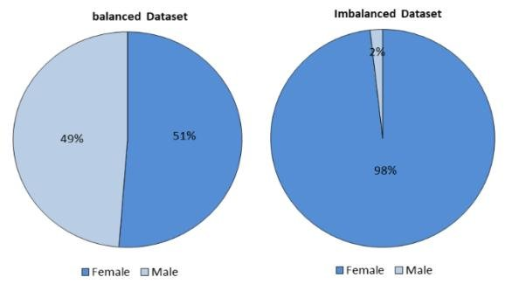
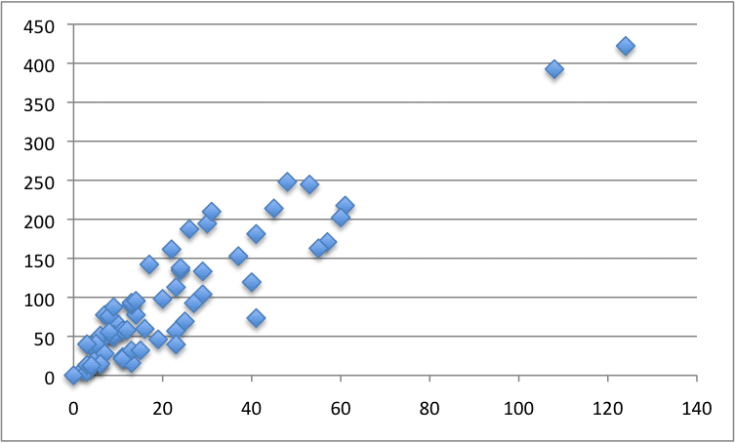
Some Data Collection Issues
Bias
Unbalanced
Small

Slide 19
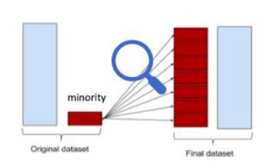
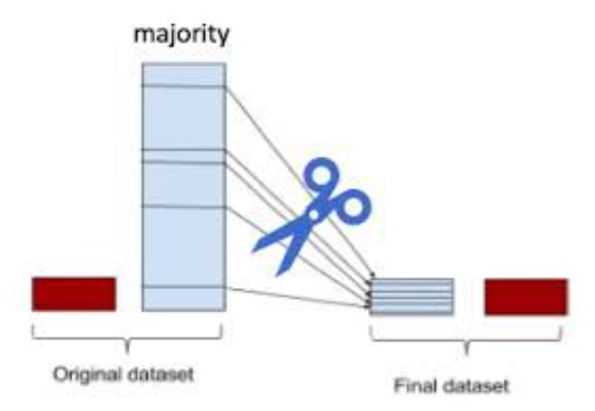
Some solutions for unbalanced dataset
Up/over sampling
Down/under sampling

Slide 20
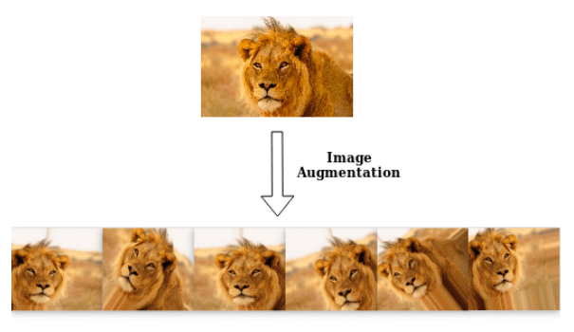
Some solutions for small size dataset
“what if we only had more data”
Collect more data.
Is it always possible?
Generate synthetic data (depends upon use case and the final goal)
Can we do it manually?
Can machine generate useful information?
Notes:
<number>

Slide 21
Some solutions for bias dataset
Sample bias
Covering all the cases you expect your model to be exposed to.
Exclusion bias
Investigate before discarding feature
Ask a domain expert
Observer and prejudice bias
Ensure observers are well trained
Having clear rules
Measurement bias
Having multiple measuring devices

Slide 22
Data Cleansing & Preprocessing
Format: The data might be spread in different files
Data Cleaning: the goal is to deal with missing values and remove unwanted characters from the data
Remove unwanted data
Manage unwanted outliers

Slide 23
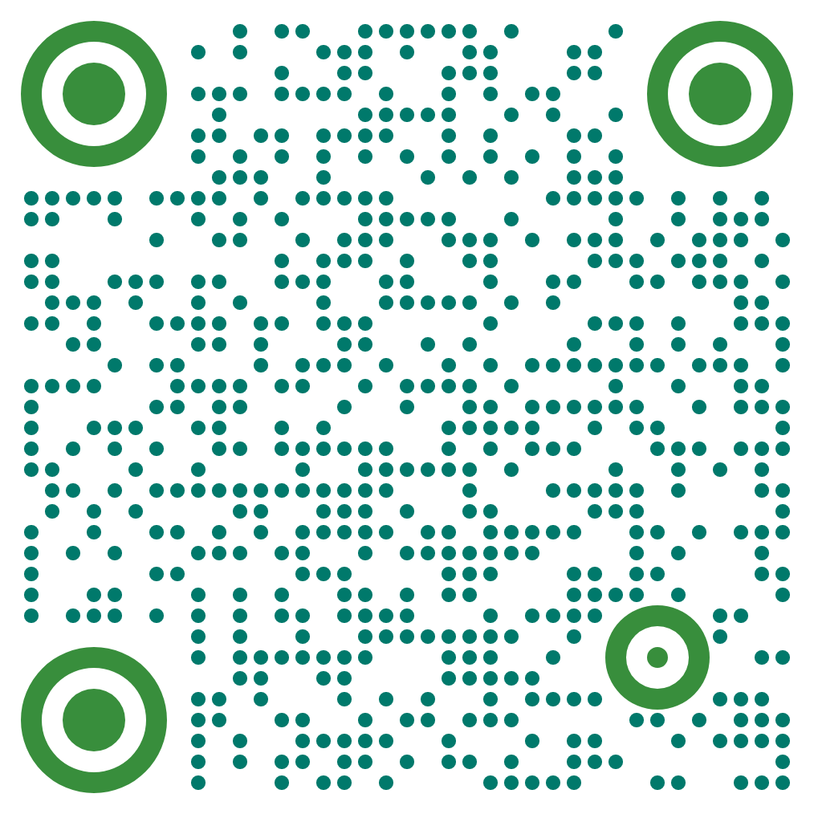
Feature Selection and Feature Extraction
Feature: Individual measurable property or characteristic of a phenomenon being observed
Selection: Choosing a subset of the original pool of features.
Extraction: Getting useful features from existing data.

Slide 24
Train, Validation, and Test Sets
How to split?
Mainly depends on:
the total number of samples in your data

Slide 25
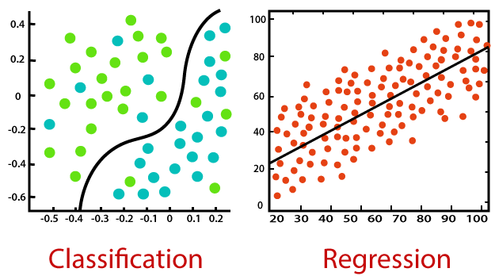
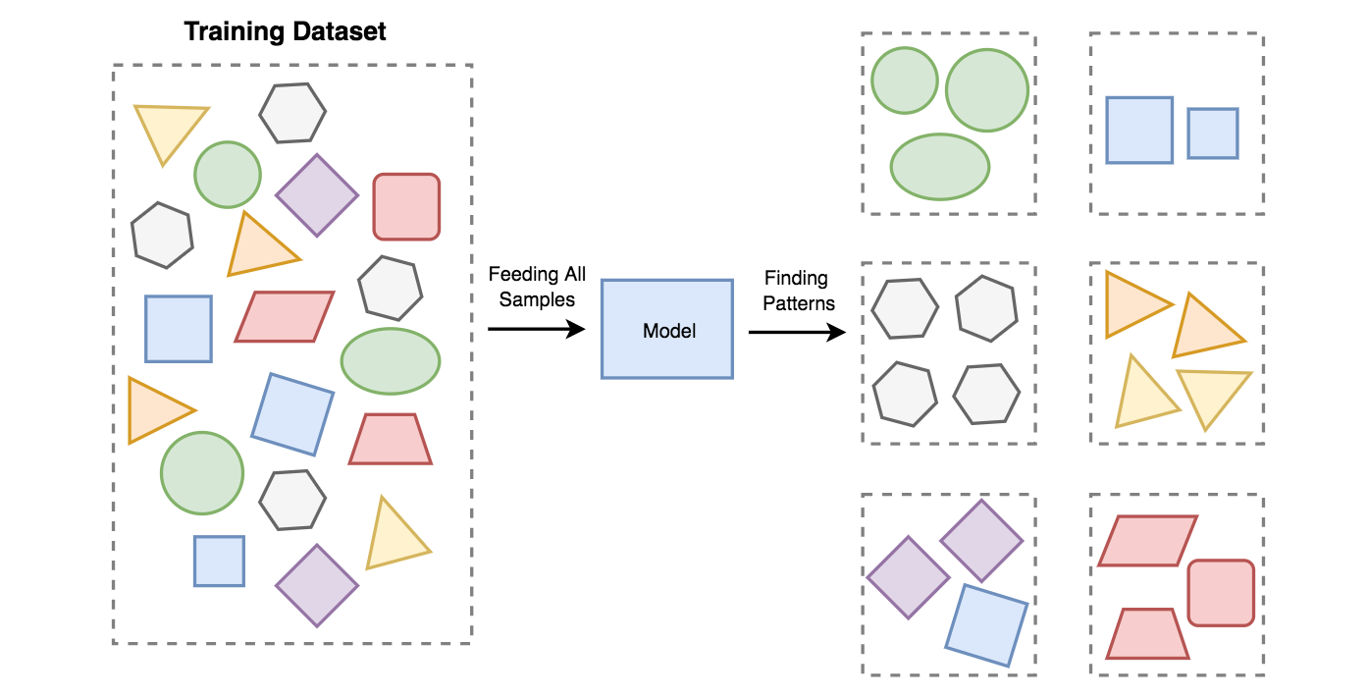
Training
Regression models
Linear regression
Polynomial
…
Classification models
KNN
Decision tree
Logistic regression
SVM
…
Clustering models
K-means
Hierarchy
DBSCAN
…
Notes:
<number>

Slide 26
Overfitting & Underfitting
Underfitting: Model performs poor under both training and test sets.
Solutions:
Add more data
Try different features or more features
Try for longer
Reduce dropout nodes
Try a more complex model (increasing #layer & #neurons)
Overfitting: Model predicts training data well but fails to generalize to test data.
Solutions:
Add more data / data augmentation
Early stopping
Reduce model complexity (reducing #layer & #neurons)
Notes:
<number>

Slide 27
Evaluation
How we can evaluate the performance of our developed model?
Metrices:
Root Mean Squared Error (RMSE)
Mean Absolute Percentage Error (MAPE)
Median Absolute Error (MedAE)
Accuracy
Confusion matrix

Slide 28
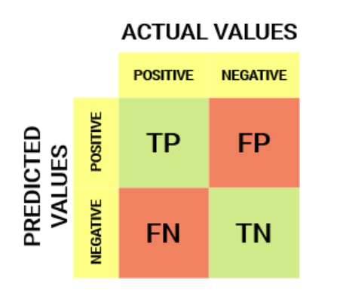
Confusion Matrix
A performance measurement for ML classification.
Applicable for two or more class classification problems.
Useful for measuring
Notes:
<number>

Slide 29
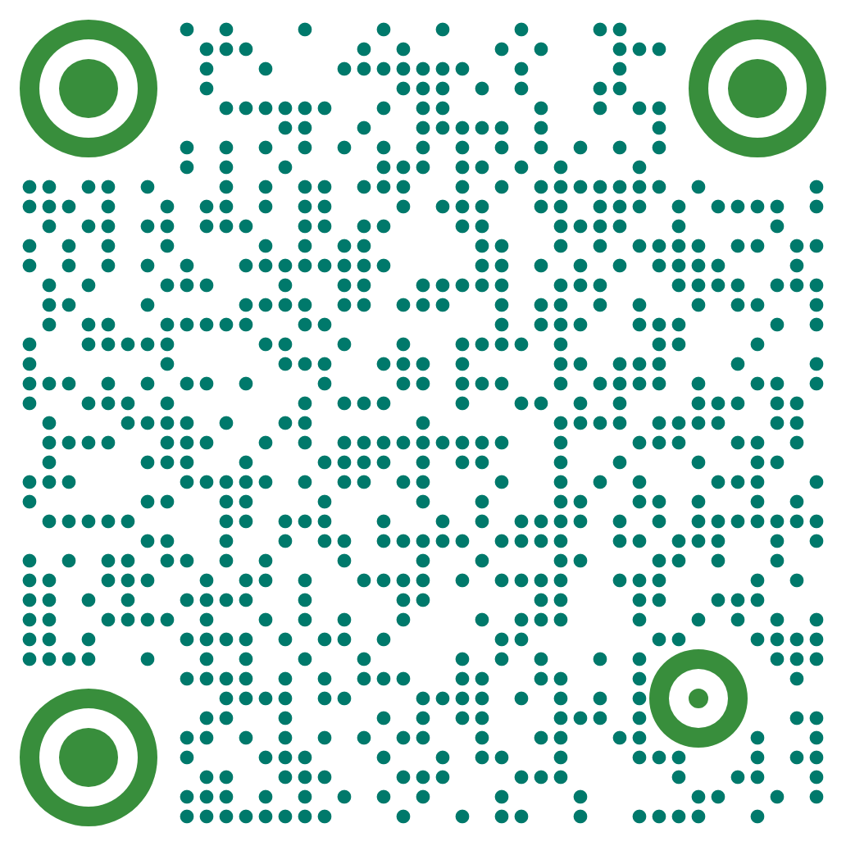
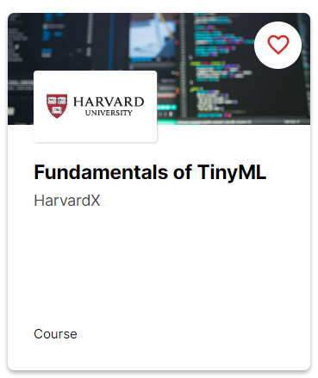
Resources

